Slide 1
SKIN CANCER DETECTION
BY
K.Prasanthi-24
M.Sukesh-34
Ch.Ani SRK-08
G.Bhargav-14
Under the Guidence of G.Karthika Mam

Slide 2
Problem Statement
Currently skin cancer is being detected by doctors by manually checking the pattern and area of affected area. Since this method is time consuming and is prone to human errors, research is being conducted to detect skin cancer automatically by using machine learning techniques.

Slide 3
Problem Solution
We use SVM for early detection of skin cancer disease. It is more advantageous to patients. The diagnosing methodology uses Image processing methods and Support Vector Machine (SVM) algorithm. The dermoscopy image of skin cancer is taken and it goes under various pre-processing technique for noise removal and image enhancement.Support vector Machine (SVM) is used for classification purpose. It classifies the given image into cancerous or non-cancerous.

Slide 4
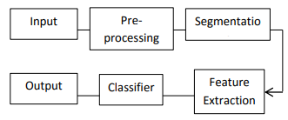
Methodology
Dataset:
https://www.kaggle.com/kmader/skin-cancer-mnist-ham10000

Slide 5
Conclusion
It can be easily concluded that the proposed system of skin cancer detection can be implemented using support vector machine to classify easily whether image is cancerous or non-cancerous.It is painless and timeless process than biopsy method. It is more advantageous to patients.

